Slide 1
Why Do We Need Normal Distribution?
Many real-life phenomena follow a common pattern:
Heights of adults
IQ scores
Student examination marks
Employee performance ratings
Most observations are concentrated around the average.
Very few observations are extremely high or extremely low.
These pattern forms a Normal Distribution, also known as the Bell-Shaped Curve.
Why is it Important?
Helps understand data distribution.
Forms the foundation of Inferential Statistics.
Used in hypothesis testing, confidence intervals, regression, and machine learning.
Enables prediction and decision-making using probability.

Slide 2
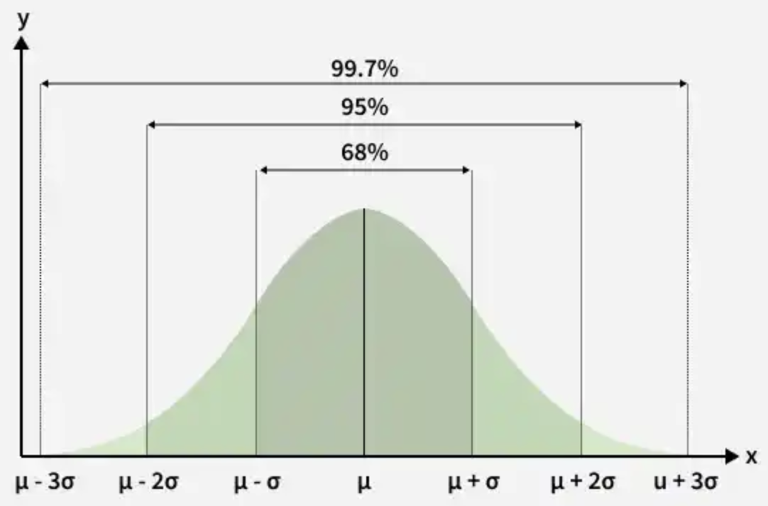
A Normal Distribution is a continuous probability distribution in which the data is symmetrically distributed around the mean. Most observations cluster near the center, while the probability of observations decreases as they move away from the mean.
The Normal Distribution is also known as the Gaussian Distribution or Bell Curve.

Slide 3
Characteristics of Normal Distribution
Bell-shaped and symmetric.
Mean = Median = Mode.
The highest point of the curve is at the mean.
Total area under the curve equals 1 (100%).
The curve extends indefinitely in both directions but never touches the X-axis.
Equal area lies on both sides of the mean.
Completely defined by two parameters:
  Mean (μ)
  Standard Deviation (σ)
Empirical Rule (68–95–99.7 Rule)
68% of observations lie within ±1σ
95% lie within ±2σ
99.7% lie within ±3σ

Slide 4
Parameters of Normal Distribution
1. Mean (μ)
Represents the center of the distribution.
Indicates the average value.
Shifting the mean moves the entire curve left or right.
2. Standard Deviation (σ)
Measures the spread of the data.
Small σ → Narrow and taller curve.
Large σ → Wider and flatter curve.

Slide 5
Applications of Normal Distribution
Finance
Risk assessment
Portfolio analysis
Stock return modeling
Healthcare
Blood pressure analysis
Clinical research
Medical measurements
Education
Student performance analysis
Standardized test scores
Business
Sales forecasting
Demand prediction
Customer behavior analysis

Slide 6
Population vs Sample
A population is the complete set of individuals, objects, observations, or measurements that we are interested in studying.
A sample is a subset of the population selected for analysis.
A numerical measure describing a population is called a Parameter.
A numerical measure describing a sample is called a Statistic.

Slide 7
Use a Sample When:
Population is extremely large.
Studying the entire population is expensive.
Data collection is time-consuming.
Testing is destructive.
Quick decisions are required.
Use the Entire Population When:
Population size is small and manageable.
Complete data is easily available.
Very high accuracy is required.
Data collection is inexpensive and feasible.
Every observation must be considered.

Slide 8
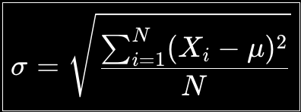
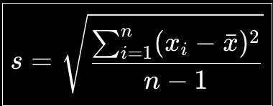
Sample Standard Deviation
Population Standard Deviation

Slide 9
Why is Sampling Important?
Reduces cost
Saves time
Makes large-scale studies practical
Enables faster business decisions
Allows estimation of population characteristics
Forms the foundation of Inferential Statistics

Slide 10
Population vs Sample
The monthly sales (₹ lakh) of five branches of a company are:
10, 12, 14, 16, 18
Assume these are all branches of the company.
Find Population Mean and Population Standard Deviation.

Slide 11
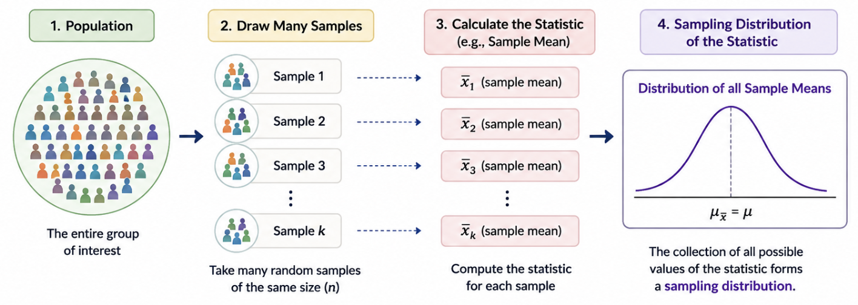
Sampling Distribution
A sampling distribution is the probability graph of a specific value (like the average) calculated from many different random samples of the same size taken from a large group.

Slide 12
Factors Influencing Sampling Distribution
Sample Size (n): As sample size increases, Standard Error decreases.
Sampling Method: Random and unbiased sampling gives more reliable results.
Population Variability: More variation in the population leads to more variation among sample statistics.

Slide 13
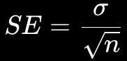
Standard Error (SE)
For the sampling distribution of the mean:
Where:
SE = Standard Error of the Mean
σ (sigma) = Population Standard Deviation
n = Sample Size
√n = Square root of the sample size
As the sample size increases: n↑ ⇒SE↓
Standard Error tells us how much a sample statistic, such as the sample mean, is expected to vary from sample to sample.

Slide 14
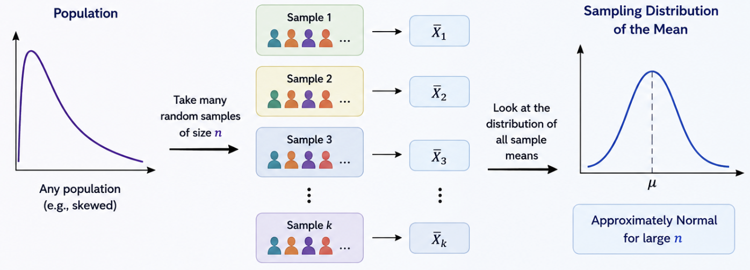
Central Limit Theorem (CLT)
The Central Limit Theorem states that the distribution of sample means approaches a normal bell-shaped distribution as the sample size gets larger, regardless of the original population's shape.

Slide 15
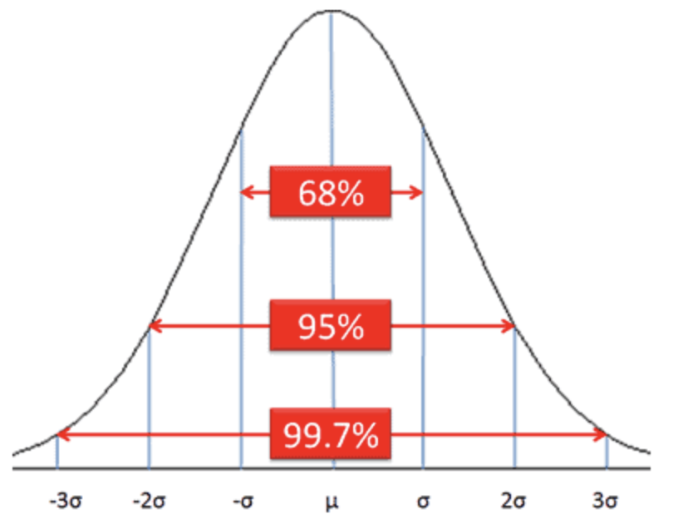
Applications of CLT
As sample size increases, the sampling distribution of the mean generally becomes more nearly normal and less variable.
Applications :
Business Decision-Making
Customer spending analysis
Demand forecasting
Quality control
Financial analysis
Market research
2. Large-Scale Surveys - A sample can be used to make statistical inferences about a much larger population

Slide 16
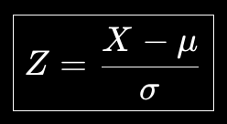
Z - Score
A z-score measures how many standard deviations a specific data point is away from the mean (average) of a dataset.
Z-score of 0 means the data point is exactly at the mean.
Positive Z-score indicates the data point is above the mean.
Negative Z-score indicates the data point is below the mean.
Where:
X = Observed value
μ = Population mean
σ = Population standard deviation
Z = Z-score

Slide 17
Z - Score
A z-score measures how many standard deviations a specific data point is away from the mean (average) of a dataset.
You score 500 on the GATE examination.
The mean score is 390 and the standard deviation is 45.
How well did you perform compared to other test-takers?
Step 1: Identify the Given Values: X = 500, μ = 390, σ = 45
(500-390)/45
Step 2: Apply the Z-Score Formula (Z = 2.44)

Slide 18
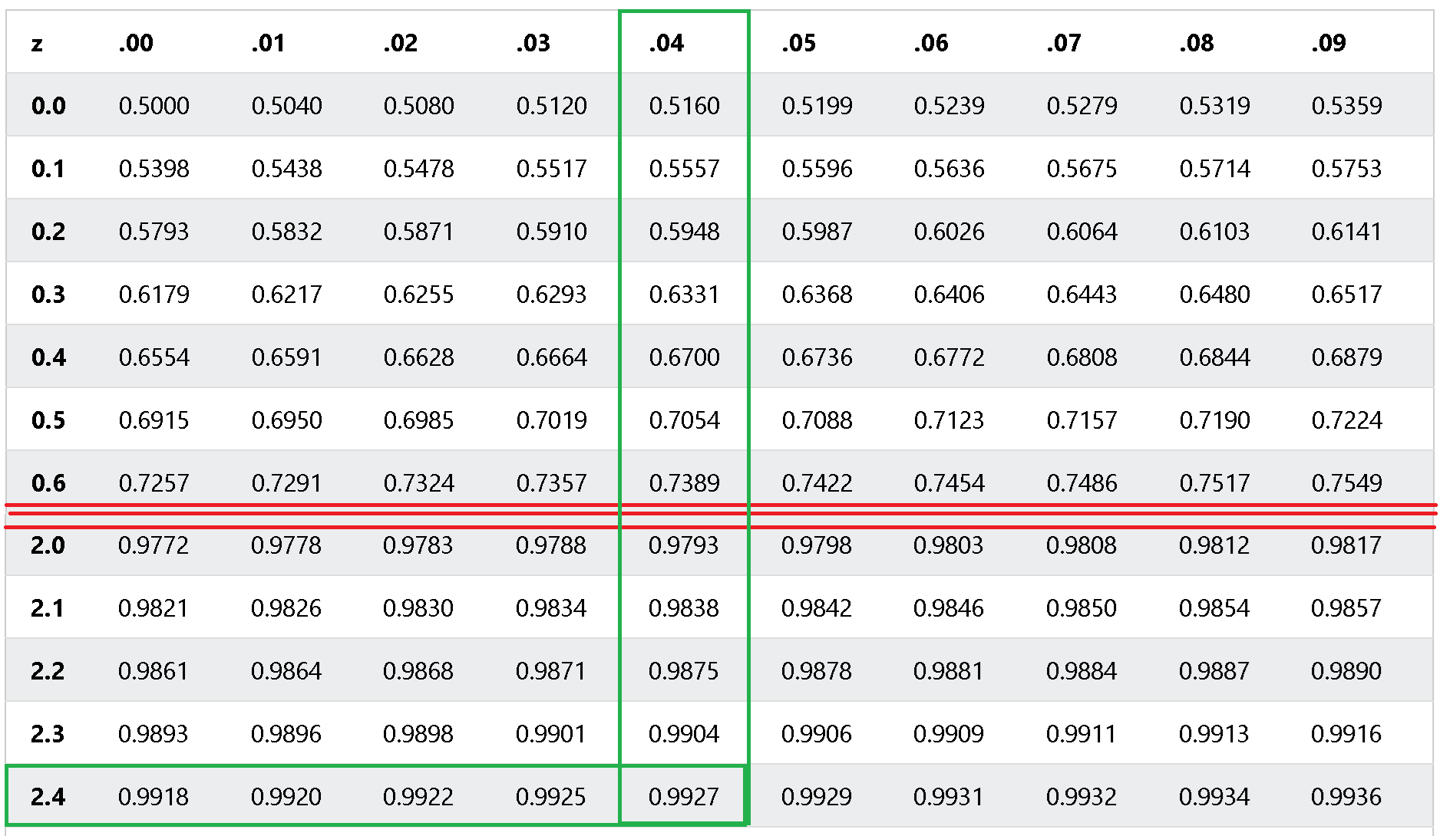
Z - Score
Step 3: Find the Probability Using the Z-Table: [(Z = 2.44)]
Split it as: 2.44 = 2.4 + 0.04
In the standard Z-table:
Y-axis / Row value
= 2.4 axis / Column value = 0.04
Find the intersection of 2.4 and 0.04.
P(Z ≤ 2.44) ≈ 0.9927
Approximately 99.27% of test-takers scored below 500.

Slide 19
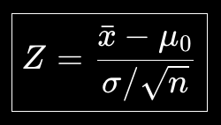
Z - Score for Sample Mean
Where:
xˉ = Sample mean
μ0​ = Hypothesized population mean
σ = Population standard deviation
n = Sample size
σ/n​ = Standard Error

Slide 20
Z - Score for Sample Mean
An e-commerce company claims that the average delivery time for its orders is 5 days.
A Business Analyst selects a random sample of 64 orders and finds:
Sample mean = 5.5 days
Population standard deviation = 2 days
Sample size = 64
Determine how many standard errors the sample mean is away from the hypothesized population mean.

Slide 21

SE = 0.25
Given
Hypothesized population mean: μ0 ​= 5 days
Sample mean: xˉ = 5.5 days
Population standard deviation: σ = 2 days
Sample size: n = 64
Therefore, Z = 2
The sample mean of 5.5 days is 2 standard errors above the hypothesized population mean of 5 days.
SE = (5.5-5) / (2/sqrt(64))
=0.5/(2/8) = 0.25
Z = (5.5-5) / (2/sqrt(64))
=0.5/0.25 =2

Slide 22
Hypothesis Testing
Hypothesis testing is a statistical method used to make a decision about a population using data collected from a sample.
We make an assumption about a population, collect sample data, and then check whether the data provides enough evidence to reject that assumption.
It usually involves two hypotheses:
Null Hypothesis (H₀): states that there is no change, no effect, or no relationship between things.
Alternative Hypothesis (H₁ or Hₐ): main guess that claims there is a real change, effect, or relationship

Slide 23
Hypothesis Testing
Example:
A company claims that the average battery life of its laptop is 10 hours.
H₀: Average battery life = 10 hours
H₁: Average battery life ≠ 10 hours
We test a sample of laptops to decide whether there is enough evidence to reject the company's claim.

Slide 24
Rejection Region
The rejection region is the range of values for which we reject the null hypothesis (H₀).
It is usually located in the tail(s) of a probability distribution.
The size of the rejection region is determined by the significance level (α), commonly: α = 0.05
For example, at a 5% significance level, the most extreme 5% of possible results form the rejection region.

Slide 25
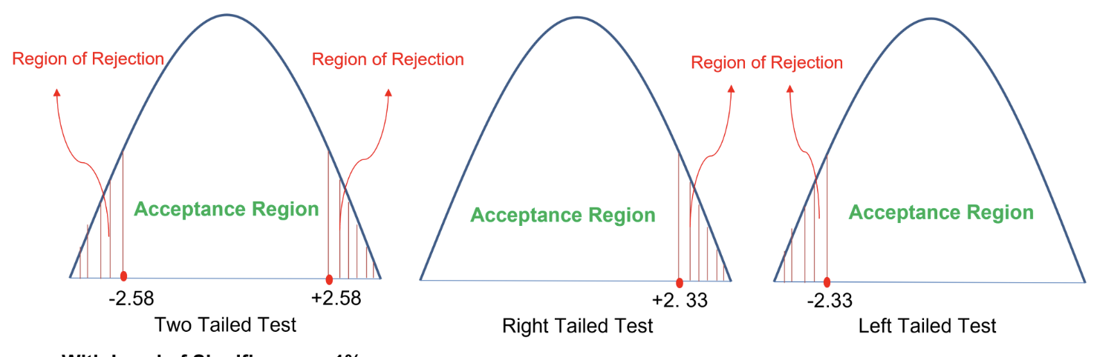

Slide 26
P - Value
The p-value represents the probability of observing the obtained results, or more extreme results, assuming that the null hypothesis is true.
P-value is the probability of getting our observed result, if the null hypothesis is true.
Decision Rule
Choose a significance level: α = 0.05
If, p ≤ 0.05​ Then, Reject H0
The result is statistically significant, i.e., there is sufficient evidence against H0.
If, p > 0.05​ Fail to reject H0
There is insufficient evidence against the null hypothesis.

Slide 27
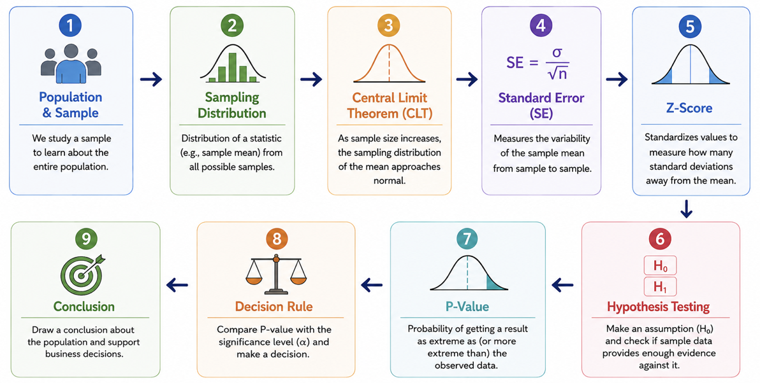
Inferential Statistics Roadmap

Slide 28
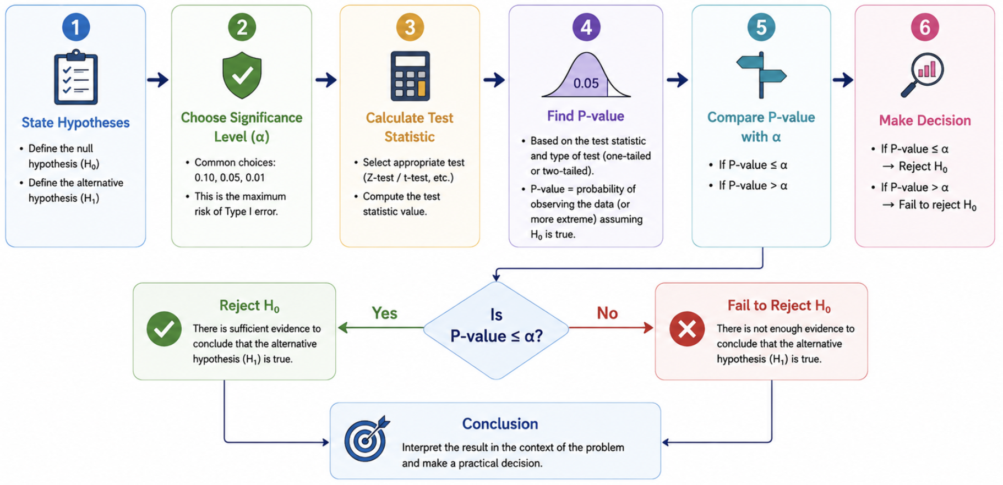
Hypothesis Testing

Slide 29
Questions
Ques 1: The marks obtained by students in a Business Analytics examination are normally distributed with:
Mean (μ) = 70
Standard deviation (σ) = 8
A student scored 86 marks.
Calculate the Z-score of the student and interpret the result.

Slide 30
Solution
Ans 1: Z = (X − μ) / σ
​Z = (86 − 70) / 8
Z = 2
The student's score is 2 standard deviations above the mean.​

Slide 31
Questions
Ques 2: An employee scored 82 in a technical assessment where:
μ = 70, σ = 8
The same employee scored 90 in a managerial assessment where:
μ = 75, σ = 10
In which assessment did the employee perform better relative to the other employees?

Slide 32
Questions
Ans 2:
Technical Assessment
Z = (82 − 70) / 8 = 1.5​
Managerial Assessment
Z = (90 − 75) / 10 = 1.5​
The employee performed equally well relative to both groups, because the Z-score is 1.5 in both assessments. the relative performance is actually the same.

Slide 33
Questions
Ques 3: Average Delivery Time
A food delivery company claims that its average delivery time is 30 minutes.
A random sample of 64 deliveries shows:
Sample mean (xˉ) = 32 minutes
Population standard deviation (σ) = 8 minutes
Significance level (α) = 0.05
Test whether the average delivery time is different from 30 minutes.

Slide 34
Solution
Ans 3: Step 1: State the Hypotheses H0: μ = 30 H1: μ ≠ 30
This is a two-tailed test.
Wording in Question | Alternative Hypothesis | Test
different from / not equal to / has changed | H1​: μ ≠ μ0​ | Two-tailed
greater than / increased / more than | H1​: μ > μ0​ | Right-tailed
less than / decreased / lower than | H1​: μ < μ0 | Left-tailed

Slide 35
Solution 3:
Step 2: Calculate the Z-Test Statistic
Z = ( xˉ − μ ) / ( σ / √n )
Z = ( 32 − 30 ) / ( 8 / √64 )
​Z = 2 / 1
​Z = 2.00
Step 3: Find the P-value
Z = 2.00
one-tail probability is approximately: 0.0228
Since this is a two-tailed test:
P = 2(0.0228)
P = 0.0456

Slide 36
Solution 3:
Step 4: Compare P-value with α
P = 0.0456 α = 0.05
Since, P < α
Decision: Reject H0
Conclusion : There is sufficient statistical evidence to conclude that the company's average delivery time is different from 30 minutes.

Slide 37
Questions 4:
Ques 4: An e-commerce company claims that its customers spend an average of ₹2,000 per order.
A sample of 100 customers gives:
Sample mean = ₹2,060
Population standard deviation = ₹300
Significance level = 0.05
Test whether the average customer spending is greater than ₹2,000.

Slide 38
Solution 4:
Step 1: Hypotheses
H0: μ = 2000
H1: μ > 2000
This is a right-tailed test.
Step 2: Calculate Z
Z = ( xˉ − μ ) / ( σ / √n )
Z = ( 2060 − 2000 ) / ( 300 / √100 ) = 60 / 30
​Z = 2.00
Step 3: Find P-value
For a right-tailed test with: Z = 2.00 P = 0.0228​
Step 4: Compare P = 0.0228 < α = 0.05
Decision: Reject H0
Conclusion: There is sufficient evidence to conclude that the average customer spending is greater than ₹2,000.

Slide 39
Note
P-value ≤ α ⇒ Reject H0
P-value > α ⇒ Fail to reject H0
Every sample belongs to exactly one population, but many different samples can be drawn from the same population.

Slide 40
Errors in Statistics
What are Statistical Errors?
In statistics, we make decisions about a population using sample data.
Because we are working with a sample, our decision may sometimes be incorrect.
A statistical error occurs when the decision made from sample data is different from the actual truth about the population.

Slide 41
Type I Error: Rejecting H0​ when H0​ is actually true.
Type II Error:Failing to reject H0​ when H0​ is actually false.
Reality | Our Decision | Error?
(H0) is True | Reject (H0) | Type I Error
(H0) is False | Fail to Reject (H0) | Type II Error

Slide 42
Example 1: Medical Testing
H0​: Patient does NOT have the disease
Type I Error - False Positive
The patient does not have the disease, but the test says: "Positive - Disease detected."
The patient is incorrectly diagnosed as having the disease.
Type II Error - False Negative
The patient actually has the disease, but the test says: "Negative - Disease not detected."
The disease is missed.

Slide 43
Example 2: Fraud Detection
H0​: The transaction is NOT fraudulent
Type I Error - False Positive
A legitimate transaction is incorrectly flagged as: "Fraudulent."
The genuine customer may have their transaction blocked.
Type II Error - False Negative
A fraudulent transaction is incorrectly classified as: "Legitimate."
The fraud goes undetected.

